Slide 1


Slide 2


Slide 3
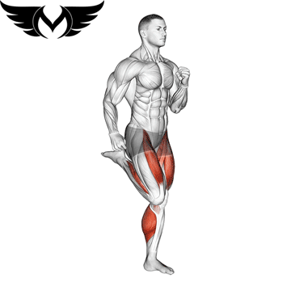
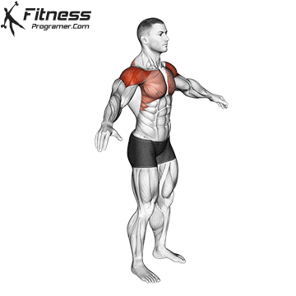
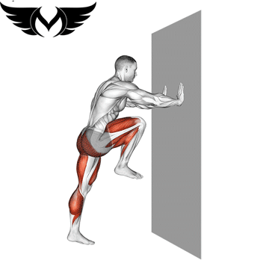
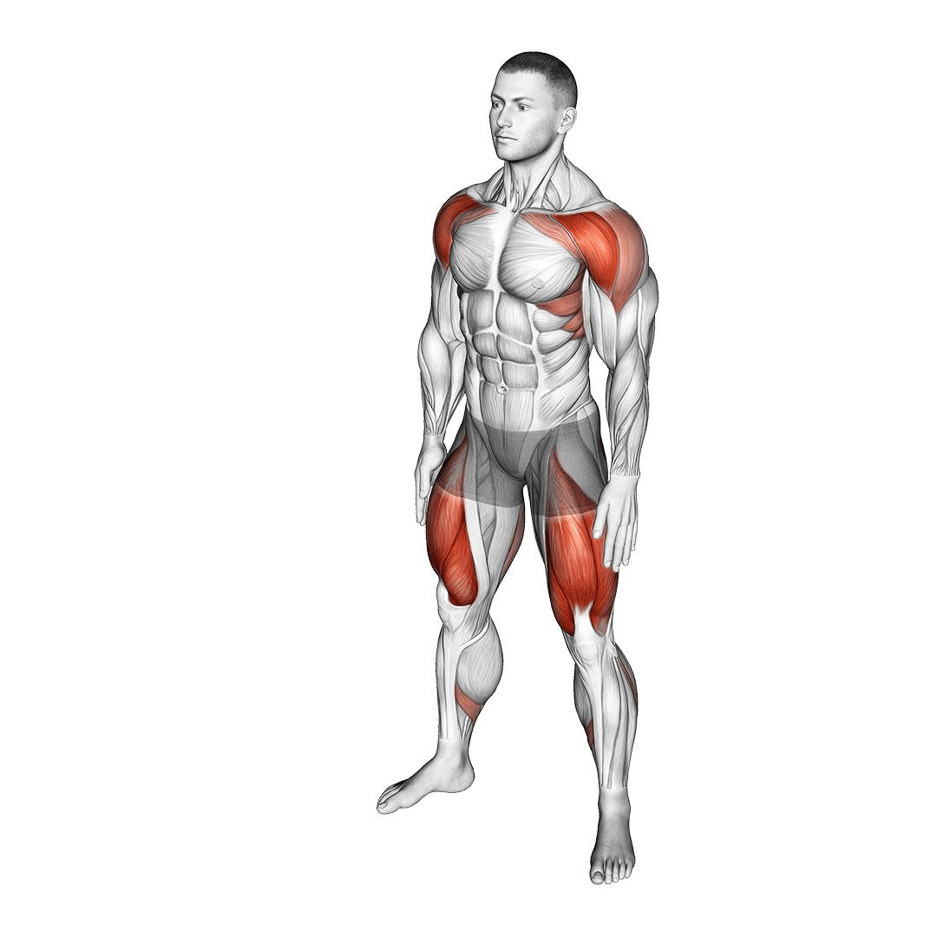
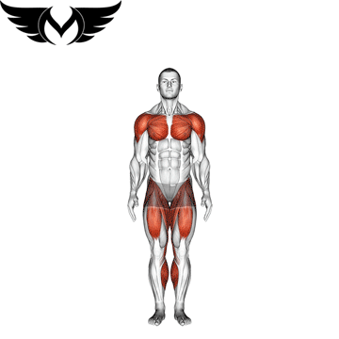
WARM UP
March in place
2 mins
30 sec on
30 sec off
2 mins
30 sec on
30 sec off
Arm circles + Soulder mobility
High knees
2 mins
30 sec on
30 sec off
2 mins
30 sec on
30 sec off
Body weight squats
2 mins
30 sec on
30 sec off
Jumping jacks

Slide 4
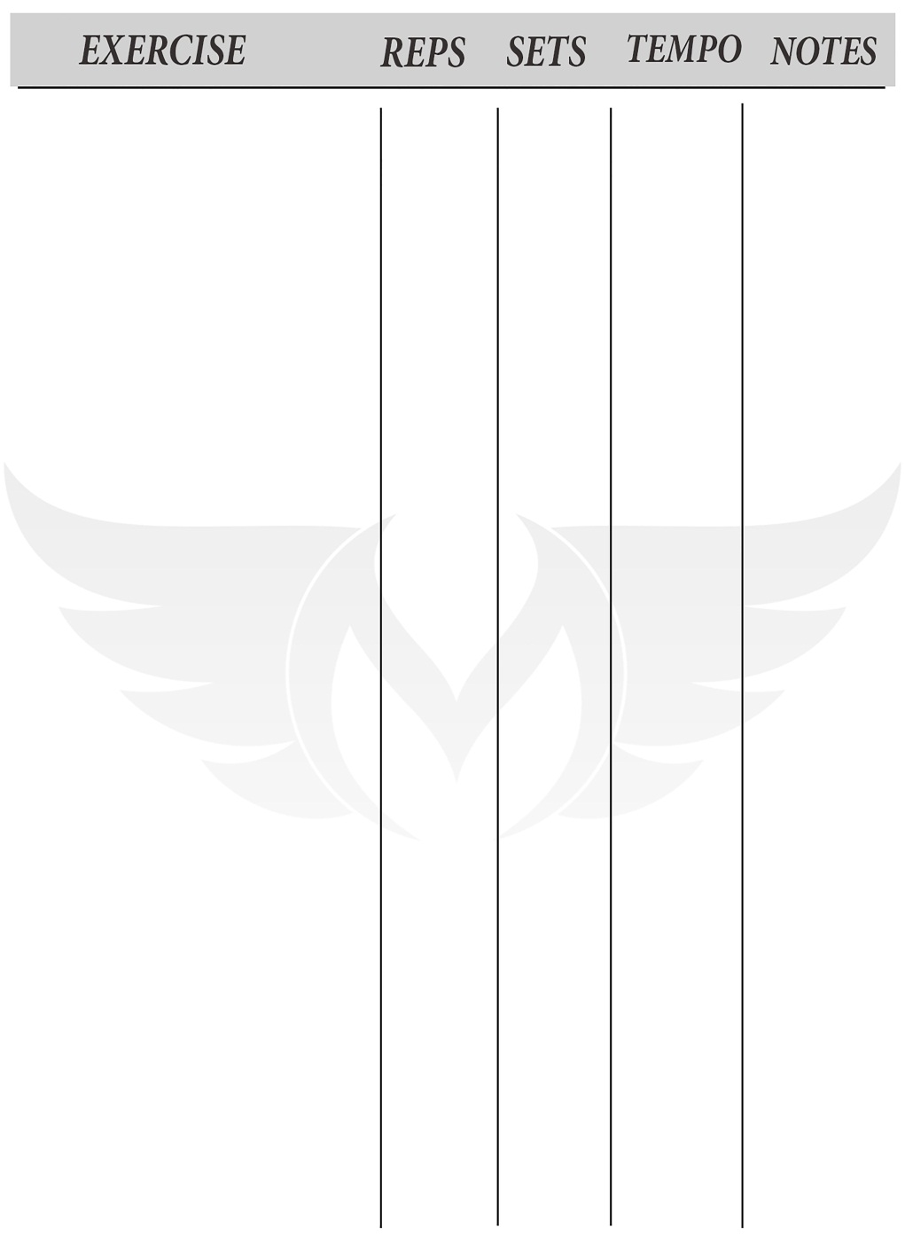
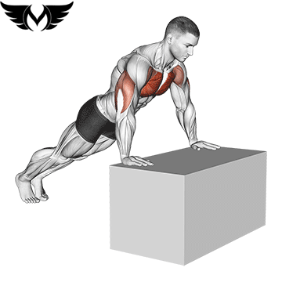
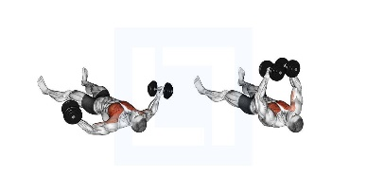
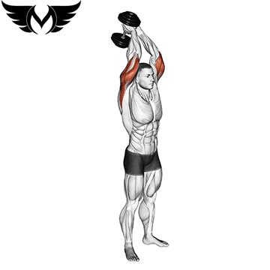
Incline Pushup
15:20
4
Rest
Between
Sets
30:45
sec
Chest fly
15:20
4
Dumbbell-Triceps-Extension
8:12
4

Slide 5
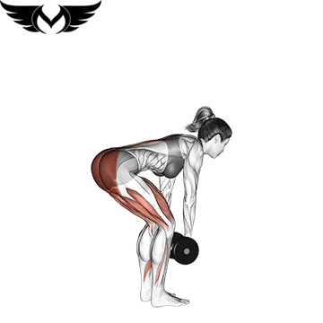
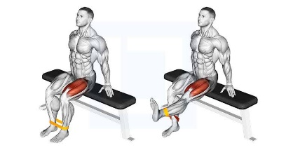
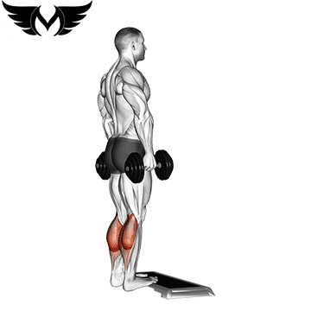
Dead lift
20
4
Rest
Between
Sets
30:45
sec
Leg extension
20
4
Dumbbell-Calf-Raise
20
4

Slide 6
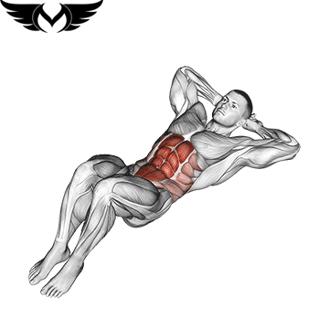
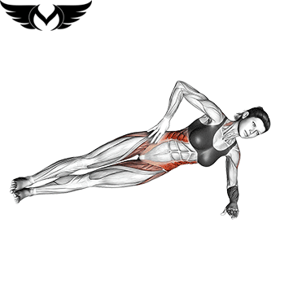
Crunch
20
4
Rest
Between
Sets
30:45
sec
side bridge
20
4

Slide 7
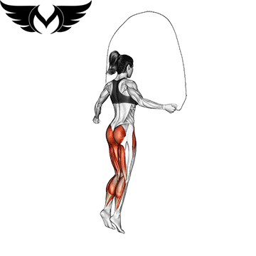
Cardio 25 : 40 min 30 sec on 30 sec off

Slide 8

2

Slide 9
WARM UP
March in place
2 mins
30 sec on
30 sec off
2 mins
30 sec on
30 sec off
Arm circles + Soulder mobility
High knees
2 mins
30 sec on
30 sec off
2 mins
30 sec on
30 sec off
Body weight squats
2 mins
30 sec on
30 sec off
Jumping jacks

Slide 10
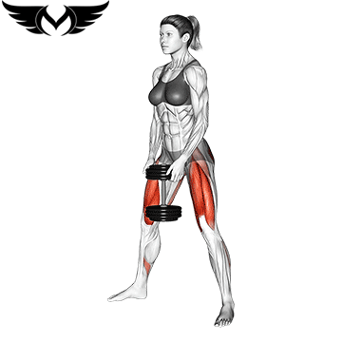
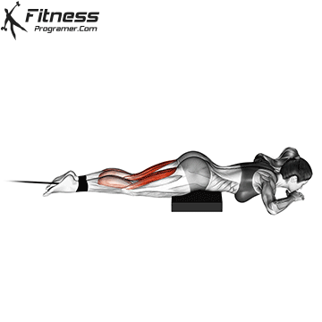
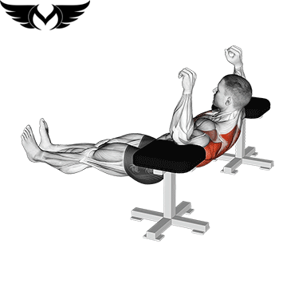
DB somo squat
12
4
Rest
Between
Sets
30:45
sec
Lying leg curl with band
15
4
Elbow-Reverse-Push-Up
15
4

Slide 11
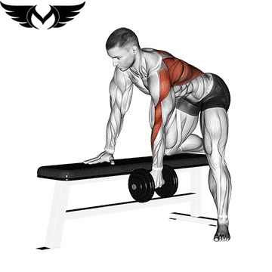
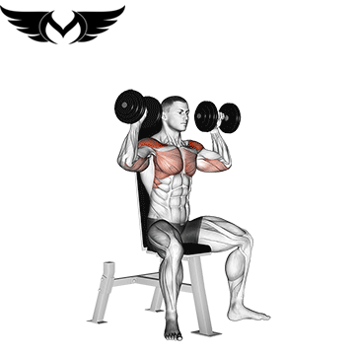
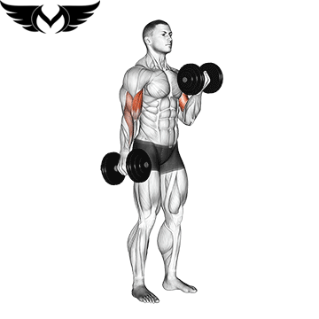
Db row
12
4
Rest
Between
Sets
30:45
sec
DB shoulder press
12
4
Biceps db curl
12
4

Slide 12
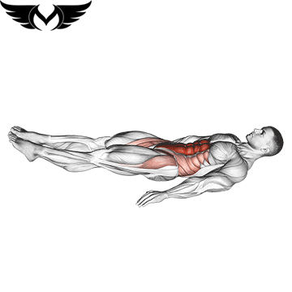
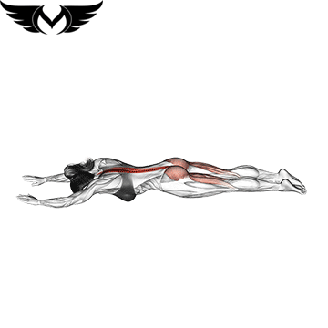
Lying-Knee-Raise
20
4
Rest
Between
Sets
30:45
sec
superman
15
4

Slide 13
Cardio 25 : 40 min 30 sec on 30 sec off

Slide 14
3

Slide 15
WARM UP
March in place
2 mins
30 sec on
30 sec off
2 mins
30 sec on
30 sec off
Arm circles + Soulder mobility
High knees
2 mins
30 sec on
30 sec off
2 mins
30 sec on
30 sec off
Body weight squats
2 mins
30 sec on
30 sec off
Jumping jacks

Slide 16
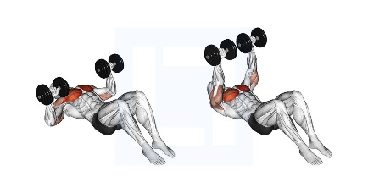
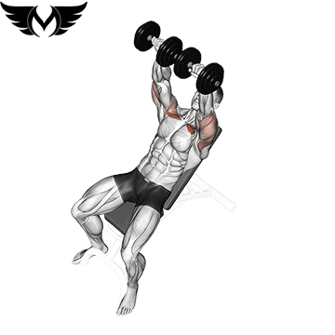
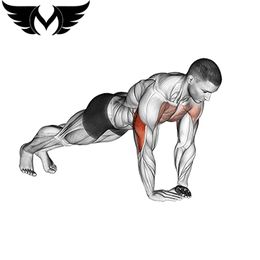
DB floor chest press
12
4
Rest
Between
Sets
30:45
sec
Chest incline press
20
4
Diamond push_ups
8_12
4

Slide 17
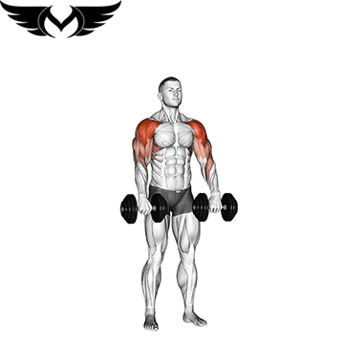
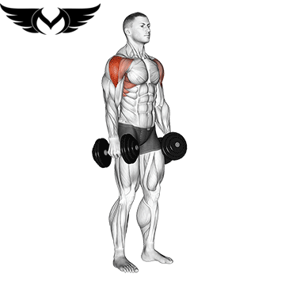
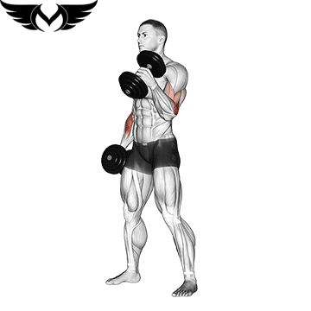
Db upright rows
15
4
Rest
Between
Sets
30:45
sec
Db -Lateral-Raise
15
4
Hammer-Curl
12
4

Slide 18
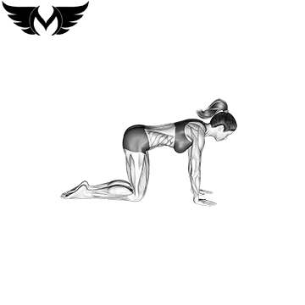
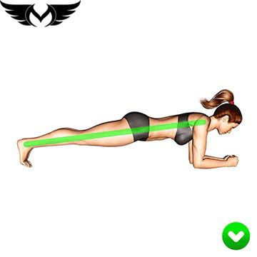
arm leg raises
20
4
plank
Rest
Between
Sets
30:45
sec
30:60
sec
4

Slide 19
Cardio 25 : 40 min 30 sec on 30 sec off

Slide 20
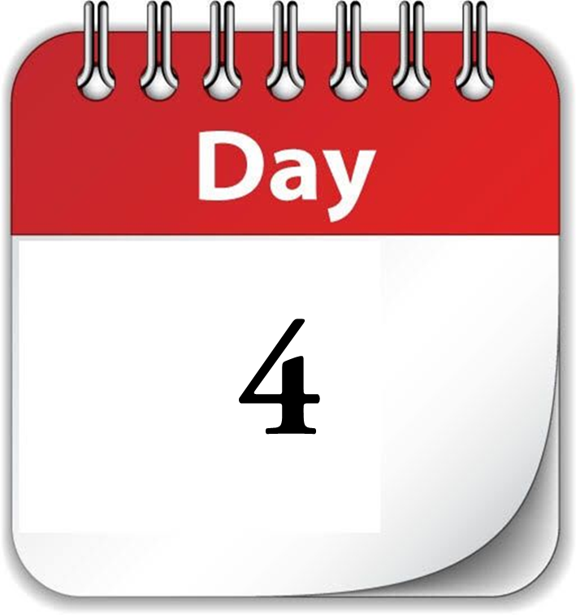

Slide 21
REST

Slide 22
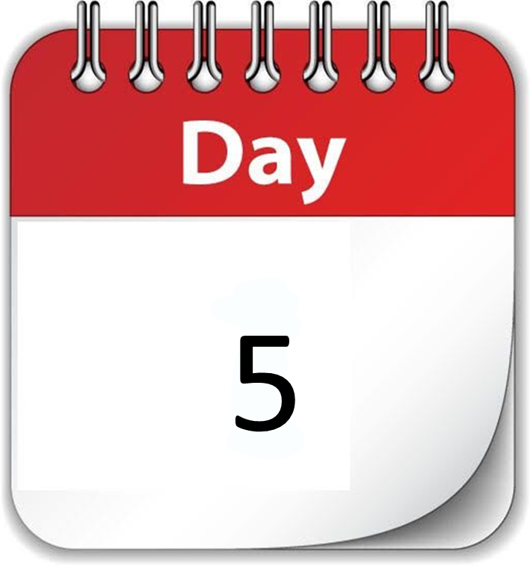

Slide 23
WARM UP
March in place
2 mins
30 sec on
30 sec off
2 mins
30 sec on
30 sec off
Arm circles + Soulder mobility
High knees
2 mins
30 sec on
30 sec off
2 mins
30 sec on
30 sec off
Body weight squats
2 mins
30 sec on
30 sec off
Jumping jacks

Slide 24
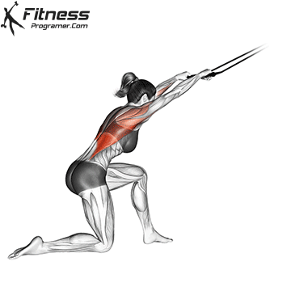

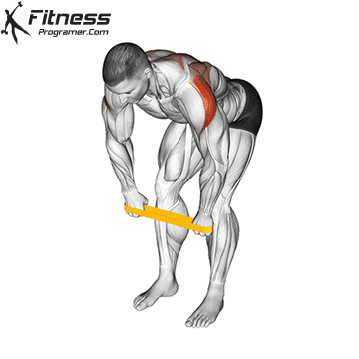
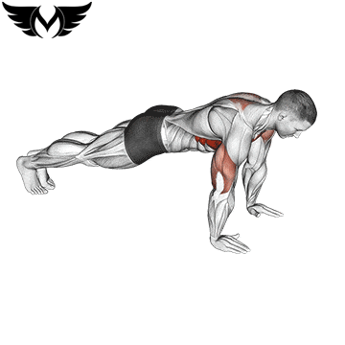
Kneeling-pulldown
15
4
Rest
Between
Sets
30:45
sec
R-Band-Bent-Over-Rear-Delt-Fly
15
4
Chest push up
12
4

Slide 25
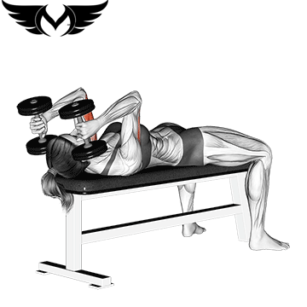
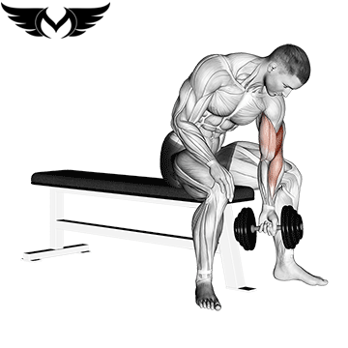
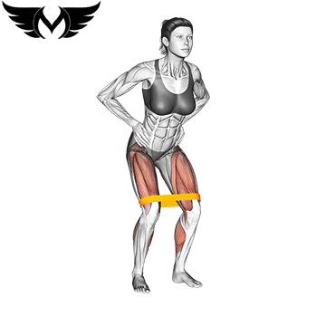
DB skull crusher
15
4
Rest
Between
Sets
30:45
sec
DB concentration
15
4
Resistance-Band-Toe-Touch
12
4

Slide 26
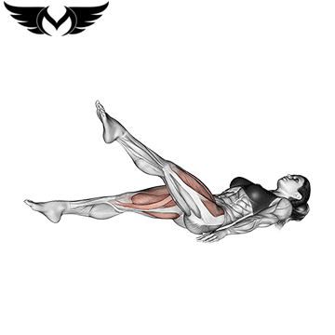
flutter Kick
15
4
Rest
Between
Sets
30:45
sec
Plank
15
4

Slide 27
Cardio 25 : 40 min 30 sec on 30 sec off

Slide 28
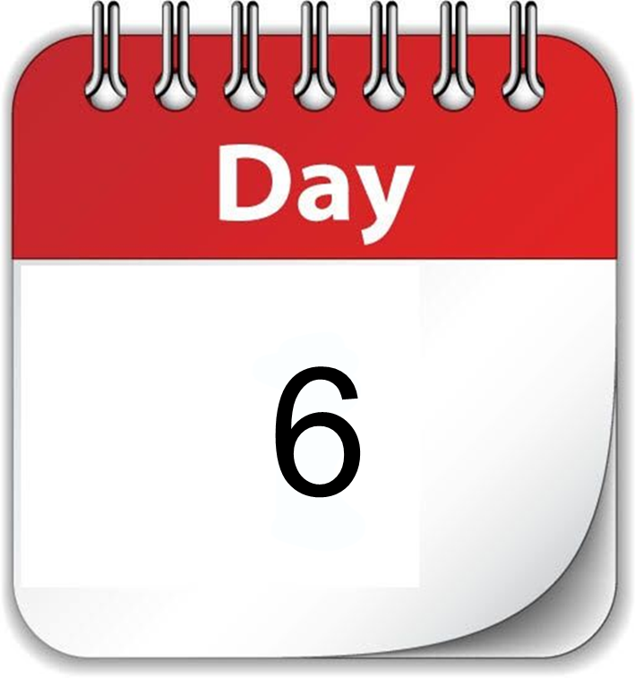

Slide 29
WARM UP
March in place
2 mins
30 sec on
30 sec off
2 mins
30 sec on
30 sec off
Arm circles + Soulder mobility
High knees
2 mins
30 sec on
30 sec off
2 mins
30 sec on
30 sec off
Body weight squats
2 mins
30 sec on
30 sec off
Jumping jacks

Slide 30


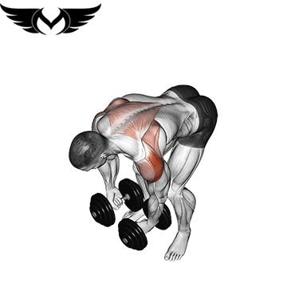
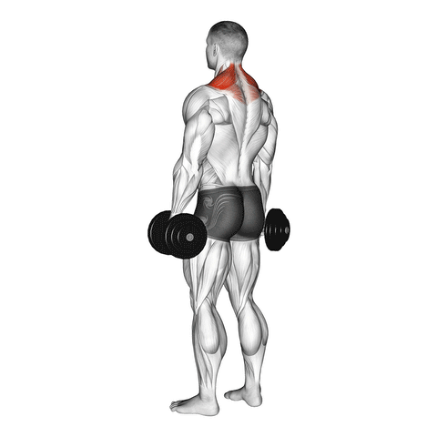

Standing-Dumbbell-Overhead-Press
15
4
Rest
Between
Sets
30:45
sec
Bent-Over-Lateral-Raise
15
4
Dumbbell shrugs
12
4

Slide 31

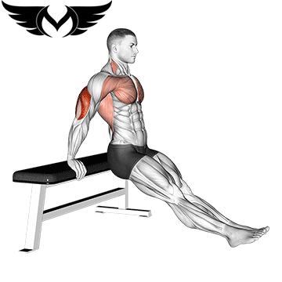
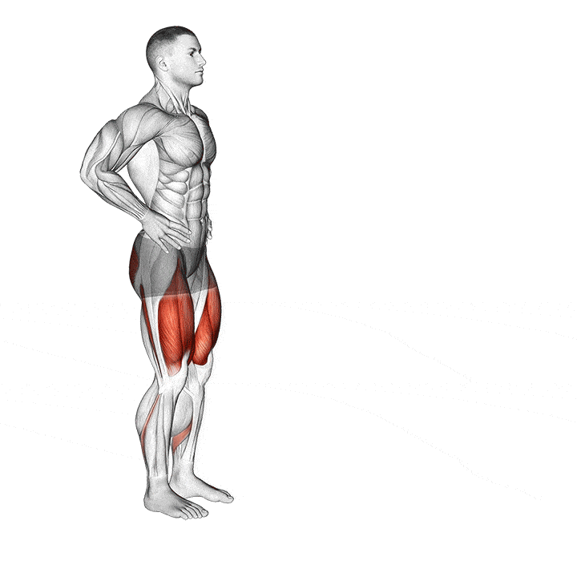
Lying leg curl with band
15
4
Rest
Between
Sets
30:45
sec
Triceps-Dips-on-Floor
15
4
lunges
20
4

Slide 32
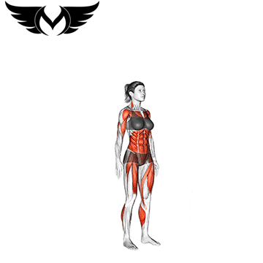
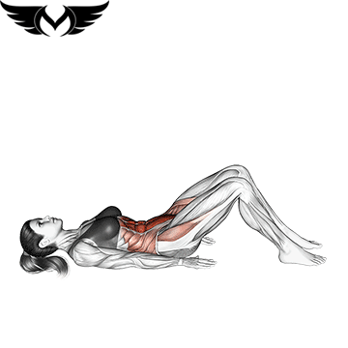
burpees
15
4
Rest
Between
Sets
30:45
sec
Leg-Pull-In-Knee-ups
15
4

Slide 33
WARM UP
5 mins before workout
After Time 25 :40 min
Every day

Slide 34
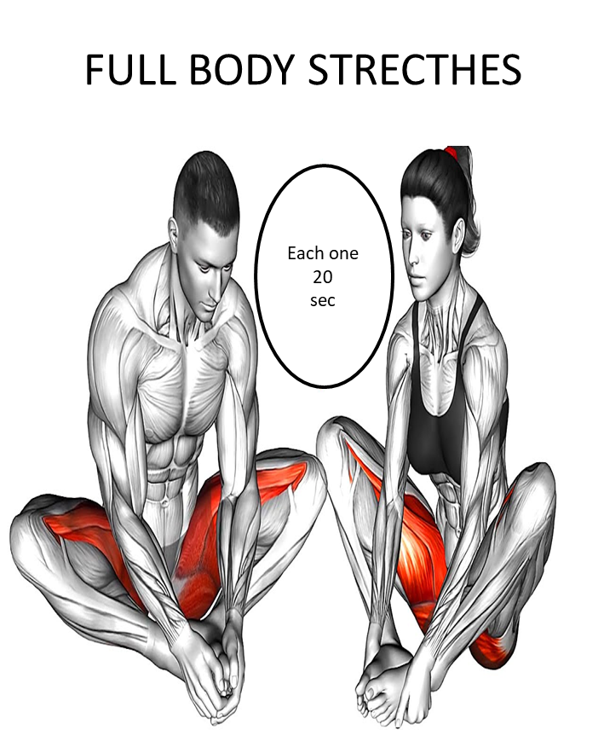
الاطالات تقدر تعملها يوم بعد يوم او
بعد كل تمرين كل شكل 20 ثانية

Slide 35
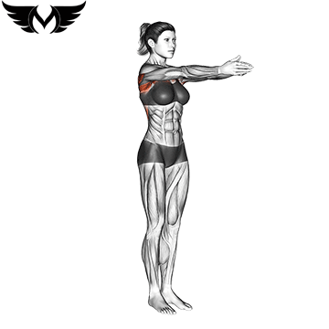
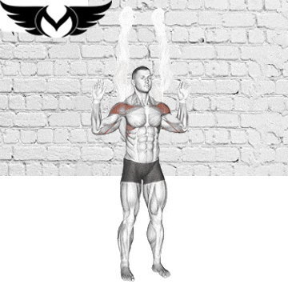






Full body stretches
Upper body stretches
2 SETS
15:20 sec

Slide 36






lower body stretches

Slide 37






lower body stretches

Slide 38


